Slide 1
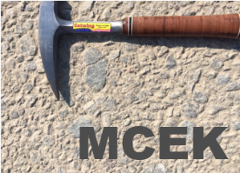
ASPASA
Technical meeting 19.03.2024
The COLTO to COTO specifications-
Implications for the aggregate industry
Presented by:
Ronnie Koen
MCEK
(road Materials and Construction Engineering Konsultant)

Slide 2
CONTENT
Specifications history
COTO process
COTO specifications content
Aggregate requirements comparison:
Crushed stone aggregate for pavement layers
Asphalt aggregate
Surface treatment (seal) aggregate
Concrete aggregate
Conclusion

Slide 3
SPECIFICATIONS HISTORY
Pre 1985 - own unique specifications
Mid 1980s - SABS 1200, TRHs, TMHs
1987 – CSRA (KSPO)
1998 - COLTO
2020 – COTO (October version)

Slide 4
COTO PROCESS
Under auspices of SANRAL
Process commenced mid 2014
SANRAL working groups and co-ordinators
Workshops in 2018, round robins in 2019
CDF submitted to RCB in December 2019
RCB converted to DS, then to COTO for approval
Released and implemented for some years
Thereafter comments reviewed, FS implemented
COLTO withdrawn, COTO full legal status

Slide 5
COTO CONTENT
Chapter (15) | Sections (91)
1. General | 8
2. Services | 4
3. Drainage | 3
4. Earthworks and Pavement layers: Materials | 5
5. Earthworks and Pavement layers: Construction | 5
6. Concrete layers | 2
7. Maintenance and repair concrete layers | 6
8. Pretreatment and repair existing layers | 9
9. Asphalt layers | 1
10. Surface treatments | 1
11. Ancillary works | 9
12. Geotechnical applications | 12
13. Structures | 14
14. Repair and rehabilitation of structures | 11
20. Quality assurance | 1
Notes:
COLTO has 8 Series (Chapters) and 55 Sections

Slide 6
CRUSHED STONE AGGREGATE
CS1. Aggregate specifications
COLTO Sections 3400 & 3600
COTO Chapter 4

Slide 7
Crushed stone (cont)
CS2. COTO Chapters 4 & 5
Chapter 4 - Producing and procuring materials
- 4.1: Borrow pits, site quarries & requirements
- 4.2: Cuttings
- 4.3: Existing roads
- 4.4: Commercial materials
- 4.5: Alternative materials
Chapter 5 – Construction
Chapter 4 – Full payment in Section 4.4

Slide 8
Crushed stone (cont.)
CS3. General specifications
Crushed stone shall not contain any visible material of:
- Organic materials, grass and shrubs
- Wood chippings, tree bark and roots
- Plastic
- Refuse
- Free asbestos
- Hazardous material (listed in Section 4.5)
Wet preparation and particle size analysis mandatory
Notes:
Dry particle size test for grading only to be used on clean non-plastic crushed stone for a quick indicator or where the fines are not critical

Slide 9
Crushed stone (cont.)
Property |  | G1 Requirement
PARENT MATERIAL |  | Sound clean unweathered high quality rock.
ADDITIONAL FINES |  | Only fines crushed from the same sound parent rock may be added for grading correction provided that added fines shall have a LL ≤ 25 and a PI ≤ 4. The quantity of fines shall not exceed 10 % by mass.
FLAKINESS INDEX |  | Flakiness index ≤ 35 on all individual fractions above 14 mm.
FRACTURED FACES |  | All faces shall be fractured faces.
SOIL CONSTANTS | Fraction smaller | E80s > 15 million | E80s ≤ 15 million
 | 0,425 mm | PI = NP. | LL ≤ 25. PI ≤ 4. LS ≤ 2 %.
 | 0,075 mm | PI ≤ 8
GRADING ENVELOPE | Sieve size (mm) | Percentage passing sieve, by mass
 | 37,5 | 100
 | 28 | 86 – 90
 | 20 | 73 – 80
 | 14 | 61 – 71
 | 5 | 37 – 49
 | 2 | 23 – 36
 | 0,425 | 11 – 20
 | 0,075 | 4 – 10

Slide 10
Crushed stone (cont.)
CS5. G1 Material definitions
Sound – adequate strength and durability
Clean – free from visible traces of materials not from the parent rock
Unweathered – fresh or faintly weathered rock with no visible signs under the naked eye of alteration in the rock material, but discontinuity planes or surfaces may be stained or discoloured

Slide 11
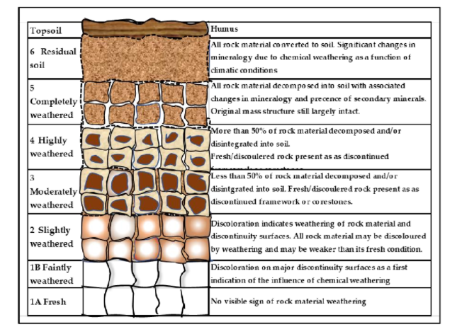
Crushed stone (cont.)
CS6. Unweathered rock

Slide 12
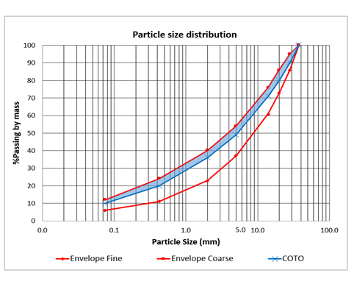
G1 COLTO/COTO grading

Slide 13
Crushed stone (cont.)
CS8. G1 Grading requirements
No target grading after trial section BUT
The grading lines, when plotted to log scale:
Shall confirm a continuous particle size distribution
1. Within the envelope,
2. Without any abrupt directional changes, or
3. Meandering

Slide 14
Crushed stone (cont.)
CS9. G4 & G5 gradings
COLTO:
- G4 3 Gradings – crushed (2) & uncrushed material
- G5 only grading modulus (GM)
COTO:
- G4A & G4B, G5A & G5B (hardness & crushing)
- G4A & G5A - COLTO G4 uncrushed envelope
- G4B & G5B - only GM
Notes:
1. G4 and G5 difference in CBR requirement: G4 - 80 % at 100 %, G5 - 45 % at 95 %

Slide 15
Crushed stone (cont.)
CS10. Durability G1 – G5A (new)
Basic crystalline rocks:
- Three sequence testing
1. 10 % FACT EG 24 hrs soaked
2. EGDI, DMI (dry), DMI (EG 5 days soaked)
3. XRD (smectite), % Secondary minerals
- Weinert N<2 Add lime at crusher
Other rocks:
- 10 % FACT dry & wet, DMI

Slide 16
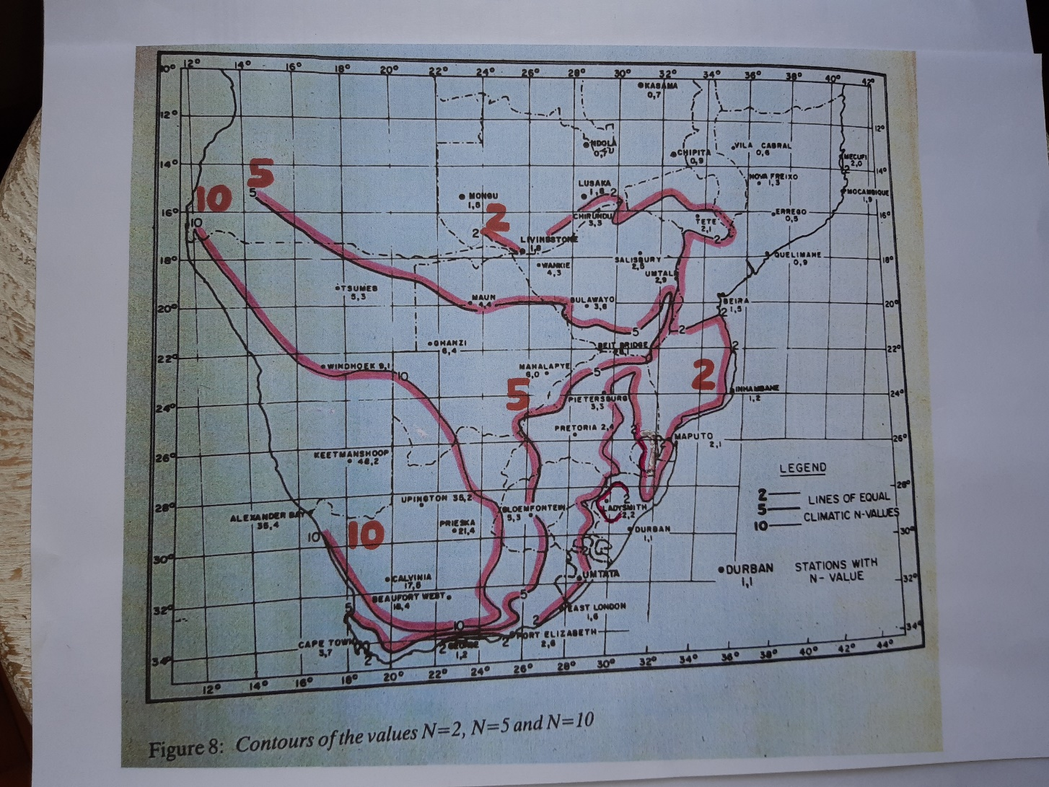
Weinert n-values

Slide 17
Crushed stone (cont.)
CS12. Deleterious minerals (new)
Sulfide minerals (sulphur content)
Soluble salts (EC), acids (pH) & sulfates
Micas:
- G1, free muscovite 2 % by mass, 4 % by volume
- Other materials, mica detected with the naked eye

Slide 18
Crushed stone (cont.)
CS13. Acceptance of material for payment
Based on a visual inspection by the Engineer and on the results of material tests as deemed appropriate by him to check compliance with the specifications, the Engineer will declare the produced commercial materials of natural gravel, sand and/or crushed rock identified and procured by the Contractor fit for use and for payment purposes before construction on the road. The Engineer’s decision for payment will be given after the material is delivered to the site and either placed in stockpile or after off-loading on the road, or when stockpiled at the supplier in terms of the requirements in Clause A4.4.5.1 as applicable.
Acceptance control testing of materials by the Engineer shall only be carried out during or after placing and construction on the road.

Slide 19
Crushed stone (cont.)
CS14. Other aggregate specifications
Pioneer material
Rockfill
Macadam materials – coarse & fine
Drainage layer material – blanket layer & sand filter

Slide 20
Crushed stone (cont.)
CS14. ASPASA G1 –G5 exclusion clauses
G4 grading envelope for uncrushed material
Weathered rock (G2-G5), shale, clay (G3-G5) or mica
After compaction grading material evaluation
Coarse sand ratio
Reduced payment for density
Target grading tolerances
Material payment for trial section

Slide 21
ASPHALT AGGREGATE
A1. COLTO (Section 4200)
Some properties differentiate between layers:
- surfacing and base
- Example FI, Fractured faces

Slide 22
Asphalt (cont.)
A2. COTO (Chapter 9 Section 9.1)
Aligned with Sabita Manual 35 / TRH 8
Some properties relate to asphalt mix type:
- stone (class 1) or sand (class 2) skeletal mixes
- Ex 10 % FACT, ACV, Fractured faces

Slide 23
Asphalt (cont.)
A3. General requirements (A9.1.5.4a and Definitions)
Hard material from crushing solid rock or boulders
Clean and free from decomposed materials, vegetable matter or any other deleterious substances
Aggregates comply latest version SANS 1083

Slide 24
Asphalt (cont.)
A4. Aggregate property comparison (COLTO changed*)
Property | COTO | COLTO
1. 10% FACT (dry) | ✓ * | ✓
2. ACV | ✓ * | ✓
3. MgSO₄ soundness | ✓
4. Methylene blue | ✓
5. FI | ✓ * | ✓
6. PSV | ✓ * | ✓
7. Fractured faces | ✓ * | ✓
8. Water absorption | ✓ | ✓
9. Sand equivalency | ✓ | ✓
10. Clay lumps | ✓

Slide 25
Asphalt (cont.)
A5. Some property differences
PSV:
- COLTO 50
- COTO also 50, but can be reduced to 45
considering material availability, traffic, road geometry and climate

Slide 26
Asphalt (cont.)
A6. COLTO vs COTO grading comparison
Definition | COLTO | COTO
1. Grading specification | Only gradings for combined aggregate in asphalt mixes | i) Coarse aggregate gradings for individual fractions ii) Also grading for crusher dust (sand)
2. Grading types | Different gradings for layers - surfacings and bases | Coarse aggregate gradings for mixes -sand and stone skeletal
3. Aggregate size | Maximum or nominal aggregate size | Nominal Maximum Particle Size (NMPS)

Slide 27
Asphalt (cont.)
A7 . COTO gradings
 | Nominal maximum particle size (NMPS) (mm)
 | 28,0 |  | 20,0 |  | 14,0 |  | 10,0 |  | 7,1 |  | 5,0
Grading grade | 1 | 2 | 1 | 2 | 1 | 2 | 1 | 2 | 1 | 2 | 1 | 2
Sieve size | Percentage passing sieve size by mass
37,5 | 100 | 100 | - | - | - | - | - | - | - | - | - | -
28,0 | 85-100 | 85-100 | 100 | 100 | - | - | - | - | - | - | - | -
20,0 | 0-20 | 0-35 | 85-100 | 85-100 | 100 | 100 | - | - | - | - | - | -
14,0 | 0-5 | 0-5 | 0-20 | 0-35 | 85-100 | 85-100 | 100 | 100
10,0 |  |  | 0-5 | 0-5 | 0-20 | 0-35 | 85-100 | 85-100 | 100 | 100
7,1 |  |  |  |  | 0-5 | 0-5 | 0-20 | 0-35 | 85-100 | 85-100 | 100 | 100
5,0 |  |  |  |  |  |  | 0-5 | 0-5 | 0-20 | 0-35 | 85-100 | 85-100

Slide 28
Asphalt (cont.)
A8. COTO grading (cont.)
Asphalt target grading fixed, aggregate tolerances:
- SANS 1083 (A9.1.5.4a)
- 10% of that agreed for the target grading (A9.1.5.4b)
Commercial suppliers not able to consistently supply all sizes – on site screening – no payment

Slide 29
Asphalt (cont.)
A9. ASPASA exclusion clauses
Weathered rock, clay, shale or mica as in COLTO 3602(a)
PSV variability – ASPASA members test houses
Grading tolerances on combined mix grading and not on target grading

Slide 30
Asphalt (cont.)
A10. Supply of asphalt aggregate
Type of mix – stone or sand skeletal
NMPS
Employer requirements (for ex D3 design form)
Project specifications (PSV reduction)

Slide 31
SURFACE TREATMENTS (SEALS)
S1. Aggregate specifications
COLTO Sections 4300 & 4400
COTO Chapter 10 Section 10.1

Slide 32
Seals (cont.)
S2. Aggregate property comparison (COLTO changed*)
Property | COTO | COLTO
1. Grading | ✓ * (A,B,C) | ✓ (1,2,3)
2. 10 % FACT (dry & wet) | ✓ * (A,B,C +wet values) | ✓ (wet %)
3. ACV |  | ✓
4. PSV | ✓ * (A,B,C) | ✓ (50)
5. FI | ✓ (A,B,C) | ✓ (1,2&3)
6. Fractured faces | ✓
7. ALD | ✓ * (A,B,C + aggr size) | ✓ (project spec)
8. EGDI | ✓ (incorrect)

Slide 33
CONCRETE AGGREGATE
C1. Aggregate specifications
Road pavements:
- COLTO Section 7100
- COTO Chapter 6 Section 6.1
Structures:
- COLTO Section 6400
- COTO Chapter 13 Section 13.4

Slide 34
Concrete (cont.)
C2. General specifications
Compliance with SANS 1083
Roads – “ Aggregates shall not contain any deleterious quantities of organic material, particular pieces of timber, grass or similar matter as assessed by visual inspection, which …..”

Slide 35
Concrete (cont.)
C3. SANS 1083 requirements (COTO changed *)
Property | Roads | Structures
1. Grading (coarse & fine) | ✓ | ✓
2. Dust content (coarse & fine) | ✓ | ✓
3. 10 % FACT | ✓ * | ✓ *
4. ACV | ✓ | ✓ *
5. FI | ✓ | ✓
6. Methylene blue absorption | ✓ | ✓
7. Clay content | ✓ | ✓
8. Fineness modulus | ✓ | ✓
9. Organic impurities | ✓ | ✓
10. Sugar presence | ✓ * | ✓ *
11. Soluble deleterious impurities | ✓ | ✓

Slide 36
Concrete (cont.)
C4. COTO requirements (COLTO changed * void **)
Property | Roads | Structures
1. NMPS | ✓ *
2. Magnesium sulfate |  | ✓ **
3. Acid insolubility of fines | ✓
4. Sand equivalent |  | ✓ **
5. Drying-shrinkage | ✓ | ✓ *
6. Low density material | ✓ ** | ✓ **
7. Soluble salts | ✓ ** | ✓ **
8. Water-soluble sulfates | ✓ ** | ✓ **
9. Shell material | ✓ ** | ✓ **
10. Alkali-aggregate reaction | ✓ | ✓

Slide 37
Conclusions
COTO is a new and different specification
COTO several additional tests
Some test requirements differ between aggregates
Find out the applicable specification
Obtain a copy of the project specifications
Find out employer additional requirements not in the specifications (ex SANRAL design forms)
Compliant material must pass all test requirements
Implement adequate process control – TMH5, Chapter 20

Slide 38
How to submit comments/ proposals
On COTO spreadsheet
To Compilers:
- Chapter 4 Pavement layers: myself
- Chapter 6 Concrete roads: Bryan Perrie
- Chapter 9 Asphalt: Herman Marais?
- Chapter 10 Seals: Gerrie van Zyl
- Chapter 13 Concrete structures: Bryan?

Slide 39
Contact details
Ronnie Koen
MCEK
Email: ronnie.mcek@gmail.com
Cell no: +2782 785 3045

Slide 40
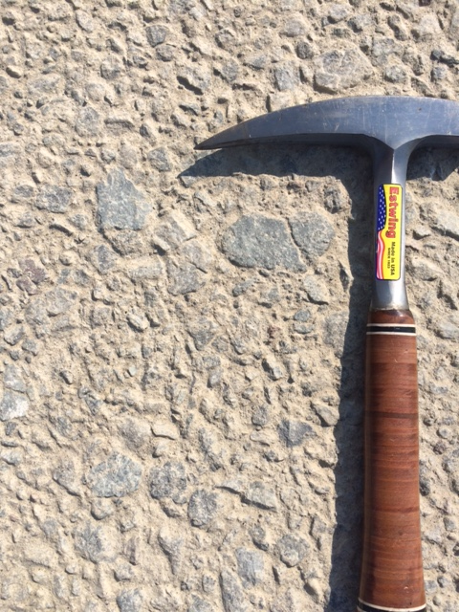
THANK YOU

