Slide 1
ASPASA PRESENTATION: SMALL SCALE MINING
ANDRÉ VAN NIEKERK
19 SEPTEMBER 2025

Slide 2
PRESENTATION LAYOUT
Introduction to Mintek
Divisional Overview: MME
Areas of Capacity
Questions

Slide 3
INTRODUCTION TO MINTEK
With a proud history extending as far back as 1934, MINTEK has become a leading provider of minerals processing and metallurgical engineering products and services to industries world-wide.
Our commitment to innovation and our world-class research and development expertise is supported by a physical infrastructure of modern laboratories, pilot plants and workshops.

Slide 4
DIVISIONAL OVERVIEW: MINING & MINERAL ECONOMICS (MME)
MME provides in-depth, multi-disciplinary, strategic market insight and policy support to clients involved directly and indirectly in the minerals industry.
Research areas are topical, integrated and focused around all parts of the mining and minerals value chain. MME is establishing competence in facilitating the rehabilitation of abandoned mines across South Africa.

Slide 5
DIVISIONAL OVERVIEW: MME
Mintek supports the artisanal small-scale mining sector through research and development of new processes, processing technologies, and environmental management.
We also produce feasibility reports, develop and adapt technologies, and provide training to individuals who can subsequently participate in gainful employment through self-employment or absorption into an existing relevant business enterprise.

Slide 6
DIVISIONAL OVERVIEW: MME
STRATEGIC GOAL:
To promote the mineral-based economies of rural and marginalised communities, through technical assistance and skills development.
NATIONAL DEVELOPMENT PLAN:
Outcome 4
Decent employment through inclusive economic growth
Outcome 7
Vibrant, equitable and sustainable rural communities with food security for all
Outcome 10
Environmental assets and natural resources that are well protected and continually enhanced
Outcome 11
Creating a better South Africa and contributing to a better and safer Africa in a better world

Slide 7
AREAS OF CAPACITY
SSM Mineral Studies
Feasibility Studies
Minerals Evaluation
Sectoral Studies
Skills Development/ Transfer
Market Research and Access
Community-level Programmes
Advisory & Support
SSM Technology

Slide 8

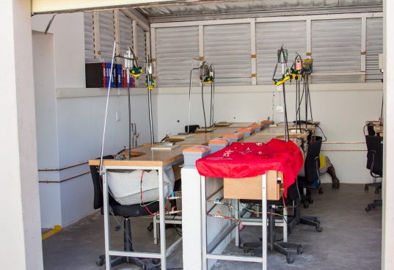
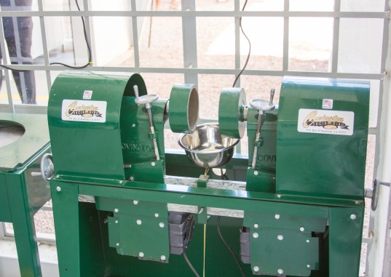
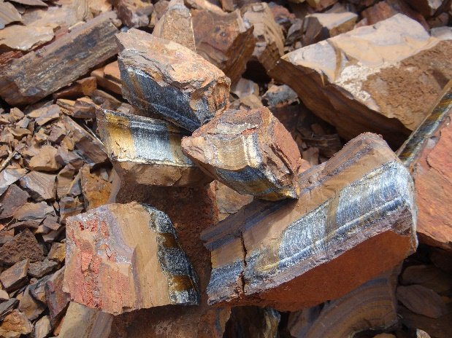
PROGRAMME: GEMSTONE BENEFICIATION

Slide 9
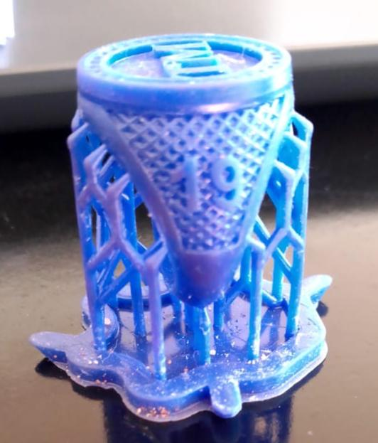
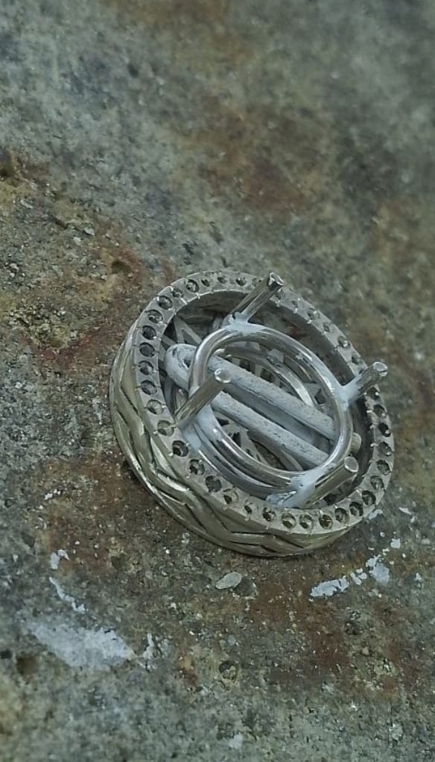
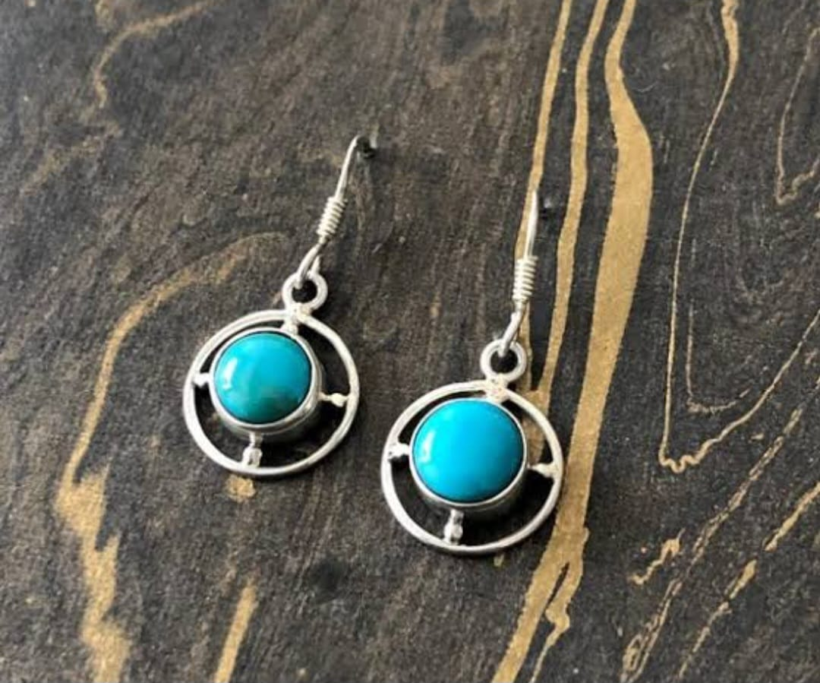
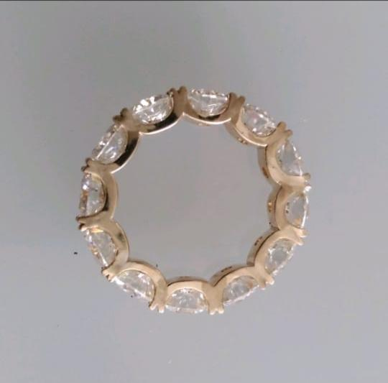
PROGRAMME: 3D PRINTING & JEWELLERY MANUFACTURE

Slide 10
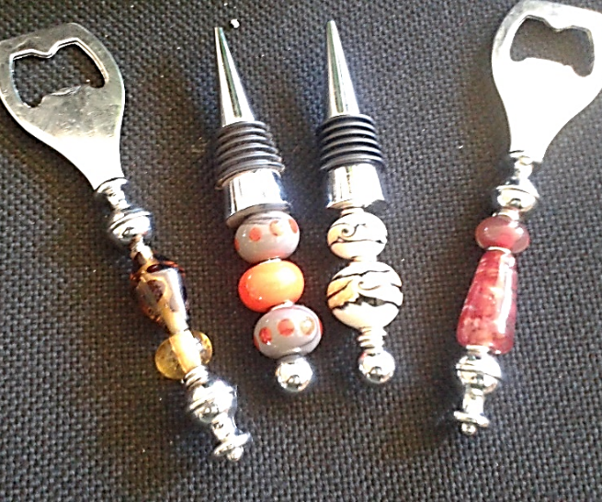



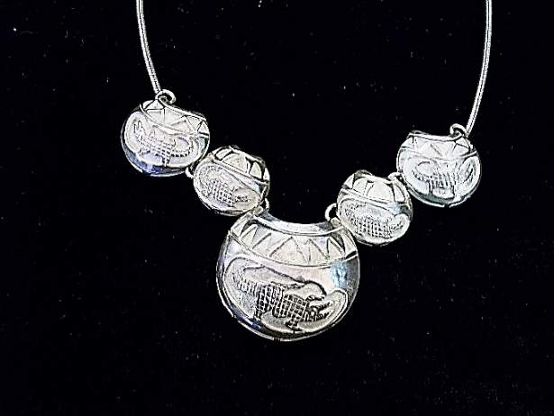
PROGRAMME: BEADS & CRAFT PRODUCTION

Slide 11
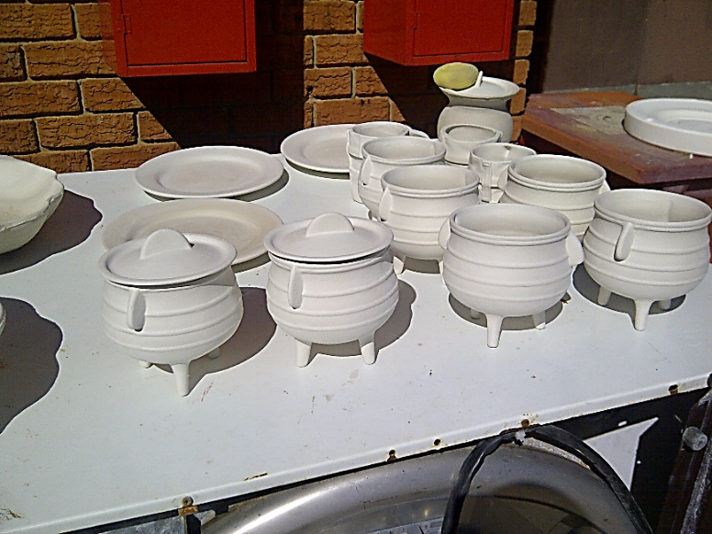
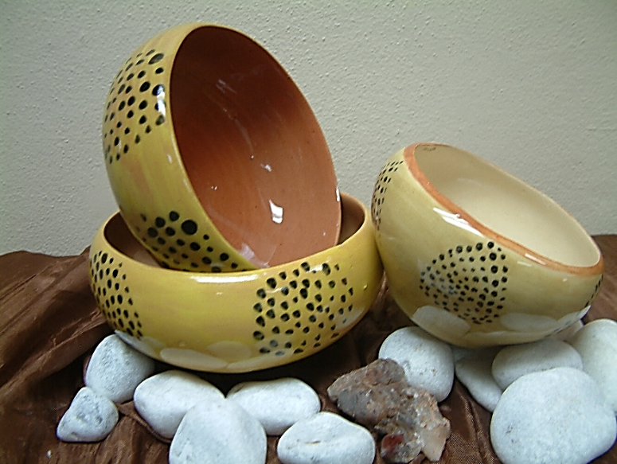
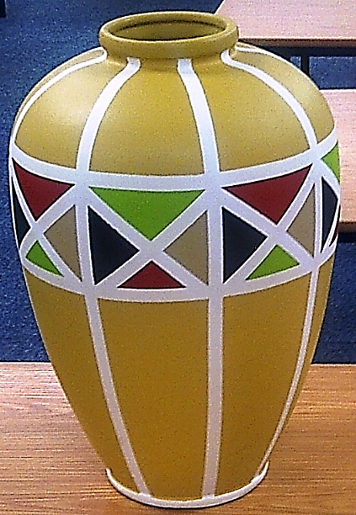

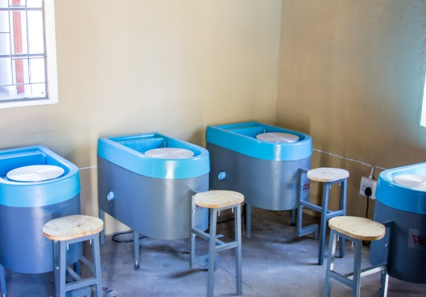
PROGRAMME: CERAMICS

Slide 12
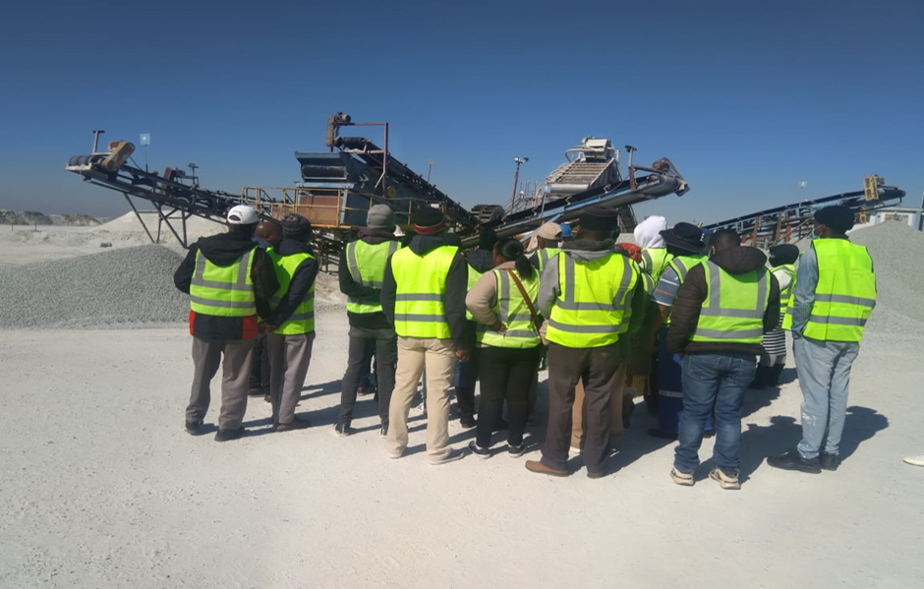
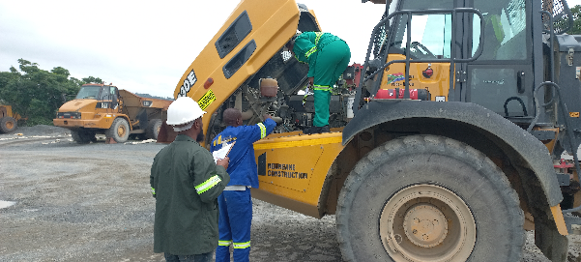
PROGRAMME: SMALL SCALE MINING TRAINING

Slide 13
THANK YOU

