Slide 1

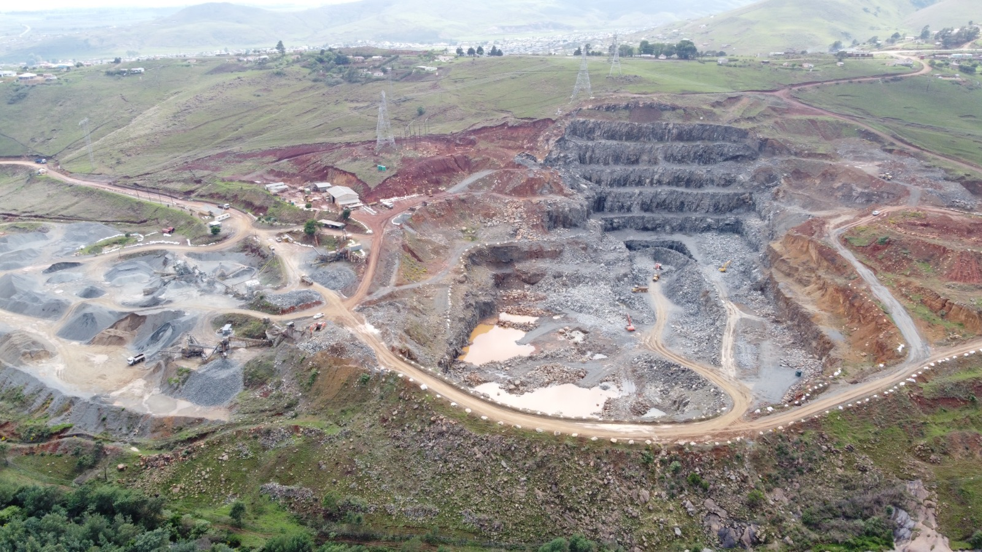



Presented by: Letisha van den Berg
Director: ASPASA

Slide 2


Slide 3
Employment Equity Act
Employment Equity Act Amendment Bill of 2020
Several controversial amendments to the Employment Equity Act 55 of 1998
Signed into law
The Minister’s power to determine sectorial numerical targets for designated employers is under the spotlight

Slide 4
Timeline to come into effect : Employment Equity Act
Employment Equity Amendment Act 2022 was approved on 6 April 2023
Not yet in force
Take affect on date fixed by the President by proclamation in the Government Gazette.
Media releases by Department of Employment and Labour take effect on 1 September 2023

Slide 5
Employment Equity Act
Major amendment
  Minister of Employment and Labour may identify sectors and publish sectoral targets after consultation with the sector
  On Friday 12 May 2023 draft five year numerical targets
  30 days to comment
    Innocent.makwarela@labour.gov.za
    Christene.lehlokoa@labour.gov.za
    Julian.mohale@labour.gov.za

Slide 6
Employment Equity Act
  Some parties have concerns on the sectorial numerical targets:
    Rigid quota
    Unconstitutional
    Entrenches categorisation of employees and applicants for employment according to race
    Wide-ranging of powers on Labour Minister
    Inconsistent with Republic’s duties under international law

Slide 7
Employment Equity Act
    Purports to allow government to prescribe demographic quotas to private employers regardless to whether they do business with state
    Not comfortable about limitation to companies with 50 or more employees – extended later
    Impact on other races
    Job losses

Slide 8
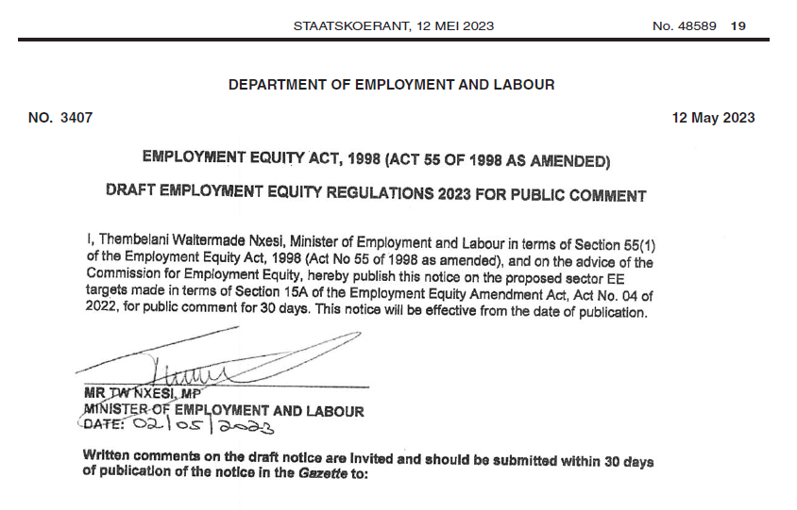

Slide 12
Question with comment
From what I understand the EE Amendment Act 4 of 2022 deletes the clause of EE Act 55 of 1998 referring
to turnover Schedule 4.
By my understanding, any employer with fewer than 50 staff is no longer a Designated Employer
and by definition does not need to submit an Employment Equity Plan (DOL), WSP & ATR.
There are three different sets of legislation involved and should be viewed separately –
Employment Equity Act:
Skills Development Act
Skills Development Levies Act

Slide 13
Interpretation
In terms of Employment Equity – The interpretation below in essence is correct, except for the linking of the EE act and the SDA and SDL Act.
Employers who employ fewer than 50 employees, will no longer be classified as designated employers. The sector turnover thresholds will therefore fall away. This means that Small, Micro and Medium Enterprises (SMMEs), will not be required to comply with certain chapters of the EE Act. Employers who have previously submitted an EE report, but who is no longer a designated employer in terms of the amended EEA, will be required to follow a deregistration process. We are not sure exactly what this process will entail, but we believe it will possibly be in available in August.

Slide 14
Interpretation
In terms of Employment Equity – The interpretation below in essence is correct, except for the linking of the EE act and the SDA and SDL Act.
Skills Development Act - is separate from the EEA and remains unchanged. Employers are not legally required to submit a WSP and ATR (not mandatory by nature). The submission of WSP / ATR is only for the purpose of claiming training grants. It should be noted that if an employer does not submit a WSP / ATR, they will not be able to claim grants from the MQA (or relevant SETA) and will also not be able to claim the training expenditure for BBBEE verification (in terms of the Skill Development element of the BBBEE scorecard).
The Skills Development Levies Act - If the Employer’s annual payroll exceeds R500 000.00, the payment of
skills levies remains mandatory regardless of the employer’s decision to submit training plans and workplace
skills reports.

Slide 15
Interpretation
Social and Labour plan
SLP has not been amended
Develop and implement comprehensive Human Resources Development Programme
Mine Community Development Plan
Housing and living conditions Plan
Employment Equity Plan
Processes to save jobs and manage downscaling
Submitted to DMRE and not DOL
Legal commitments
Maintain compliance

Slide 16

What do we comment on behalf of industry?

Slide 17


55

